Slide 1
ASPECT BASED SENTIMENT ANALYSIS ON CONSUMER REVIEWS
Project Guide:
Dr. M Venugopala Chari
Asst.Professor
By:
P Jitendra Kalyan 160114733096
R Pranith Kumar 160114733106

Slide 2
PROBLEM STATEMENT
The goal of this project is to capture real time costumer reviews and identify sentiments expressed about each Entities (ex: smart phones) and their Aspects(ex: price)

Slide 3
EXISTING METHODS
Limited in predicting sentiment to few domains
Not more than 70% accuracy
No method based on LSTMs
No real time aspect based sentiment analysing system

Slide 4
PROPOSED SYSTEM
Real time review scraping
Parsing using NLTK
Aspect categorization on reviews performed dynamically
Can help new customers, and organization understand the merits and demerits of a product

Slide 5
LITERATURE SURVEY
Title | Methodology | Result

Slide 6
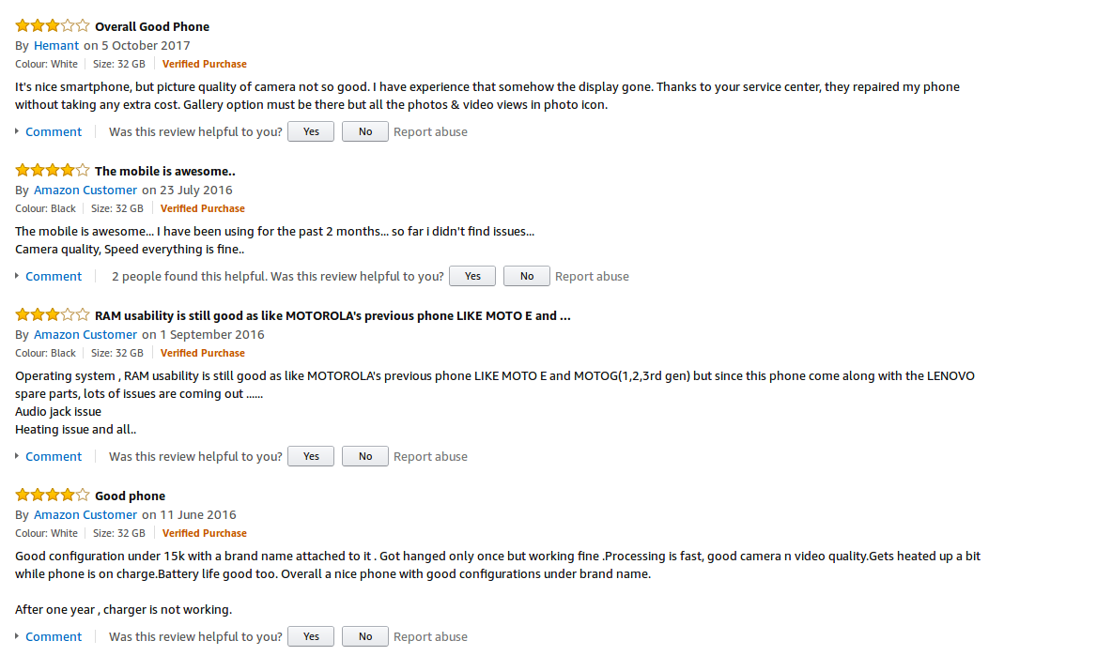
DATA
Real time data from E-commerce web sites

Slide 7
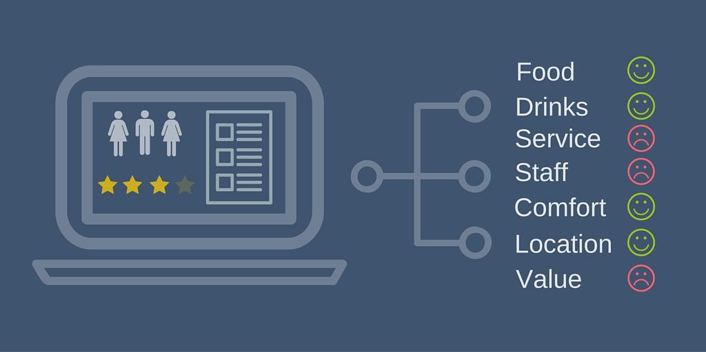
Example of ABSA

Slide 8
Progress till date
Setting up Environment
Review scraping and storing from various web sites
Pre processing raw reviews (removing stop words, spell check, stemming etc)
Parts of Speech Tagging (ongoing..)

Slide 9
Future Work
Aspect categorization
Training the classification model (LSTM)
Predicting Sentiment

Slide 10
Conclusion
Referred papers from Sem Eval 2016
Set up the environment and successfully implemented scraping
Tested existing techniques on sample data

